Slide 1
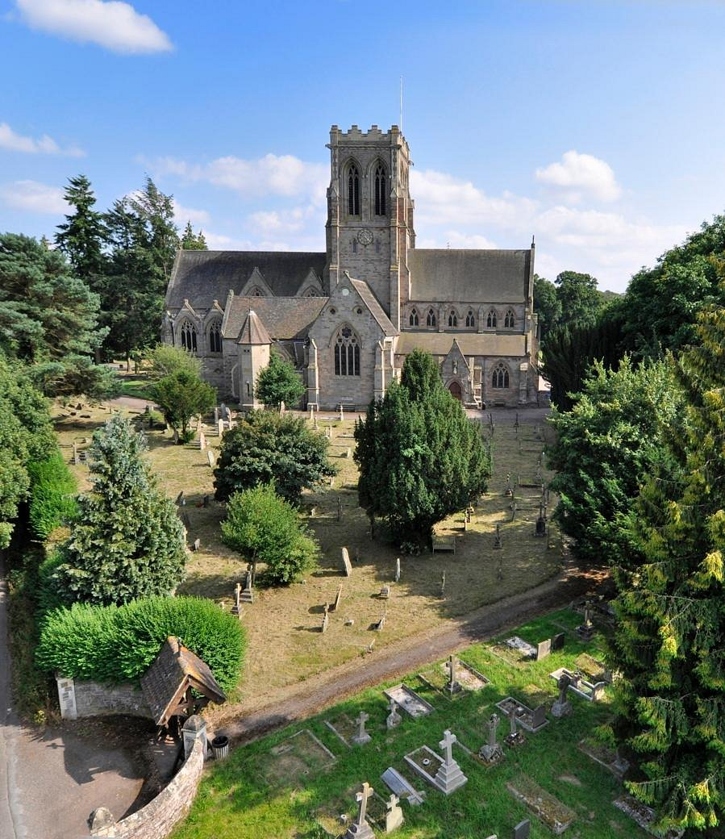
SATURDAY 11th JULY
Parish Day Out
to
BELMONT ABBEY
9.30am Minibus departs St Benedict’s
11am Visit to TINTERN ABBEY
1pm PICNIC LUNCH (bring your own)
Afternoon at Belmont
4pm MASS with the BELMONT PARISH
5.30pm Departure
7.45pm approx. return to St Benedict’s
SIGN UP AND PAY £20 cash
AT BACK OF CHURCH
13/14th and 20/21st JUNE

