Slide 1
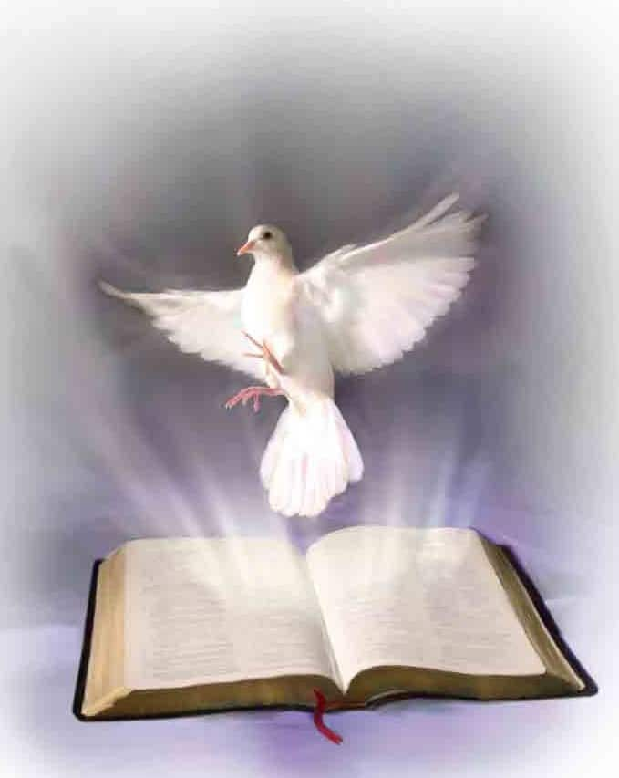
VESPERS and VIGIL MASS
on the
eve of pentecost
St Benedict’s Church, Stratton-on-the-Fosse
4.45 pm
Saturday 23rd May
Sung Vespers in the Benedictine tradition will lead straight into the Liturgy of the Word for the Pentecost Vigil followed by the Liturgy of the Eucharist.

