Slide 1
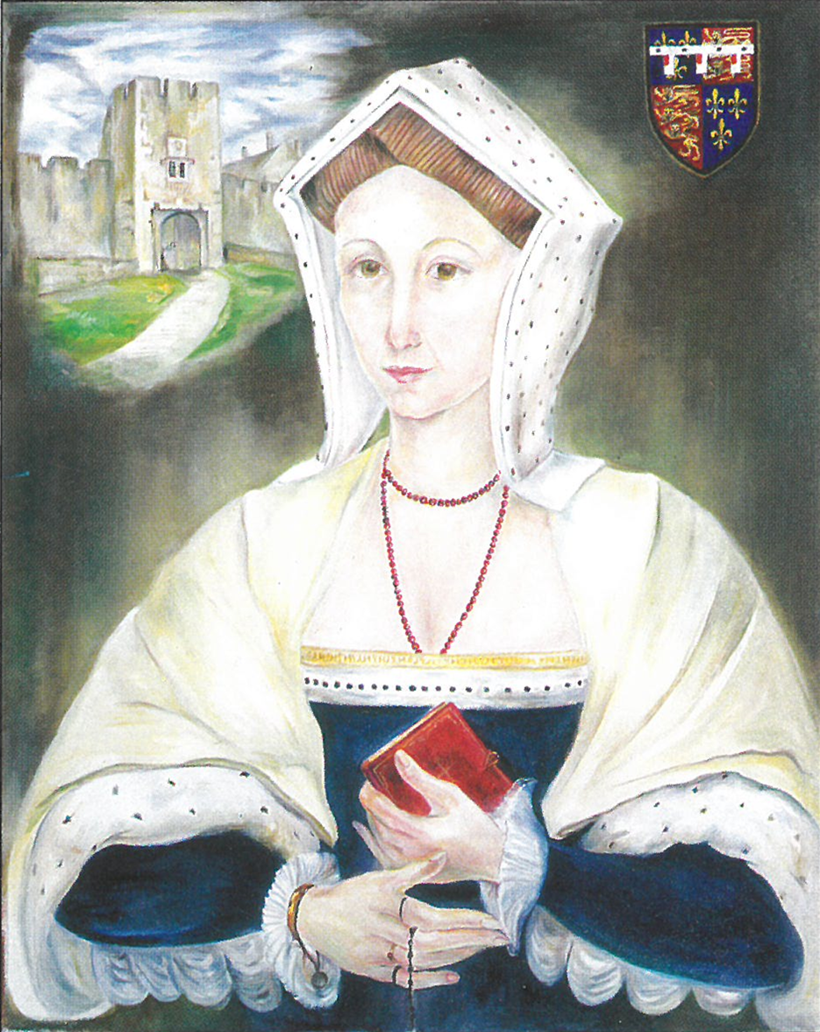
HOLY MASS in memory of Blessed Margaret Pole
Saturday May 30th
Farleigh-Hungerford Castle
6.15pm
Celebrant: Father Michael Patey
(Vigil Mass of the Holy Trinity)
PLEASE BRING A PICNIC TO ENJOY AFTER MASS.
There is no charge for entrance to the castle and the grounds are open for us to explore.
There is ample parking and toilets are available on site.
PLEASE DO NOT ARRIVE BEFORE 6PM

